Slide 1


Slide 2

Cheating on the Surgical Clerkship
Rahul J Anand, MD
Clerkship Director
Virginia Commonwealth University School of Medicine
Richmond, Virginia

Slide 3

Personal Experience

Slide 4
Case Study
During the administration of the shelf exam, you the CD get a phone call from your clerkship coordinator that they suspect cheating is going on during the administration of the shelf exam.
Coordinator says one person keeps blatantly looking at the sheet of another student.
What do you do?

Slide 5

What is Cheating?
Cheating In Medical School –
  The Unacknowledged Ailment
Copying from others
Using unauthorized notes
Sharing information about clinical encounters
Falsifying data
Plagiarizing
Kunsoor et al. South Med J. 2013; 106(8): 479-483

Slide 6
Scope of the Problem
Students surveyed upon entering and leaving medical school
358 surveys administered – response rate 87%
About 20% cheat in college
About 20 % cheated in medical school
Most common was on written exam

Slide 7
Other Studies
Sierles et al
428 4th year students
58% reported cheating once during medical school

Slide 8

Why do Students Cheat?
Peer pressure
Need for approval
Students who are more likely to cheat are
  Less Self-Sufficient
  More neurotic
  More extroverted
  Over-ambitious
Anderson et al. Acad Med. 69 (1994):323-332

Slide 9
The Hidden Curriculum
“Tacit ways in which knowledge and behavior get constructed, outside the usual course…lessons.”
Team Player
Resident Contribution
Desire to fit it
Desire to get a good evaluation
Kunsoor et al. South Med J. 2013; 106(8): 479-483

Slide 10
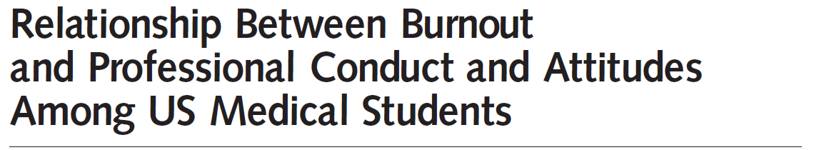

Cross sectional survey of all medical students attending 7 US medical schools
Those with burnout more likely to engage in unprofessional behavior

Slide 11
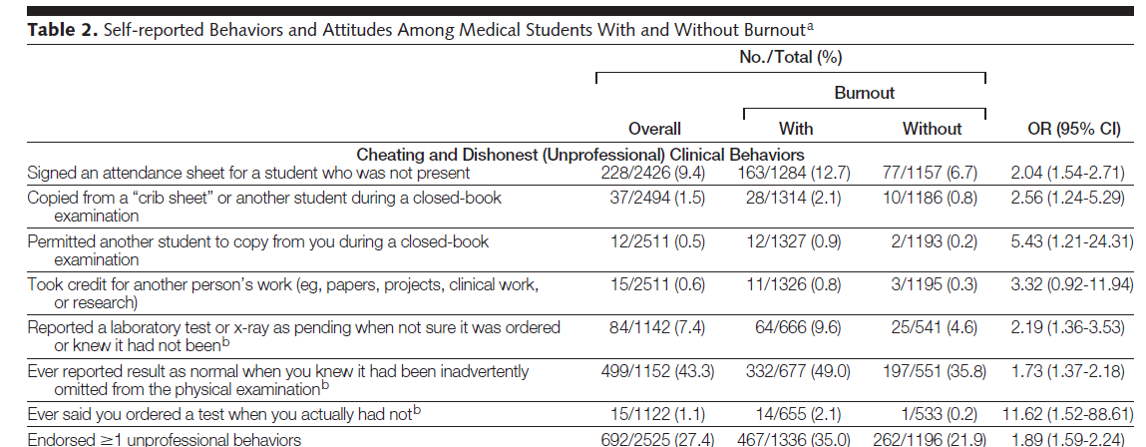

Slide 12
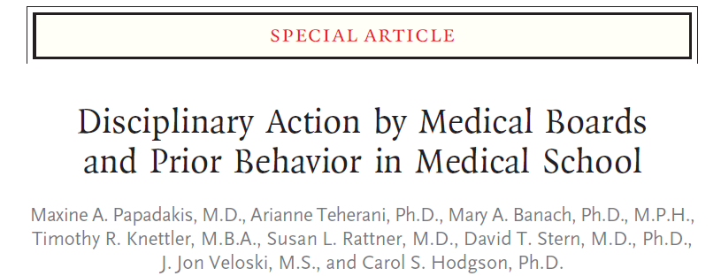
IMPORTANT!
Unprofessional behavior in medical school predicts disciplinary action by state medical boards

Slide 13
Cheating Methods
In the internet age, YOUTUBE has a variety of cheating methods involving
  Micro-writing
  Electronic gadgets
  Soft drink bottles
  Articles of Clothing

Slide 14

Soda Bottle Cheat

Slide 15
Cheating Watch

Slide 16
SO WHAT DO YOU DO IF YOU
SUSPECT CHEATING?

Slide 17
Resources Available
Office of Academic Integrity
Deans Office
NBME testing analysis
Do not try to deal with this yourself!

Slide 18
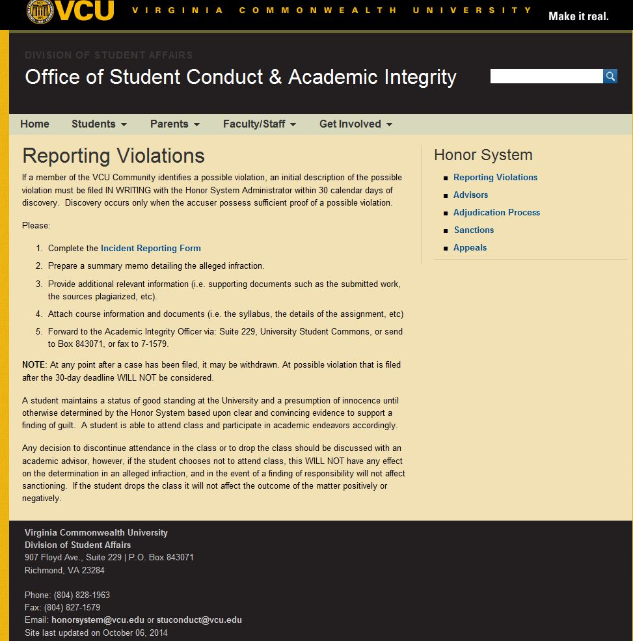

Slide 19
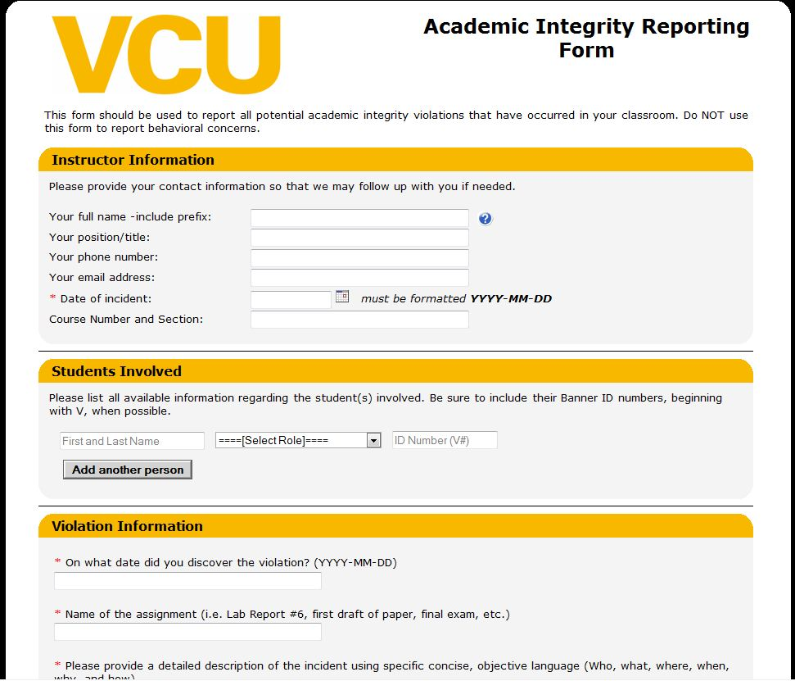

Slide 20
KNOW WHAT THE NBME CONSIDERS
CHEATING
AND HOW THEY WANT YOU TO
HANDLE IT

Slide 21
NBME – SHELF EXAM
Irregular Behavior
  Copying answers or permitting work to be copied
  Continuing to mark answers after STOP announcement
  Possessing notes or making notes

Slide 22
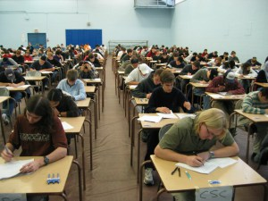
What to do during exam
Allow exam to finish
Confirm observation with one other proctor
Call the NBME for consultation if needed
Write down the seating chart

Slide 24
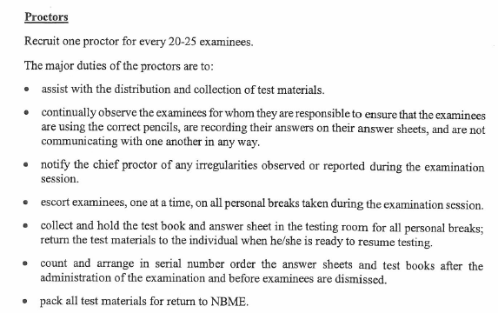
Proctors
NBME Chief Proctor’s Manual

Slide 25
Proctors
NBME Chief Proctor’s Manual

Slide 26
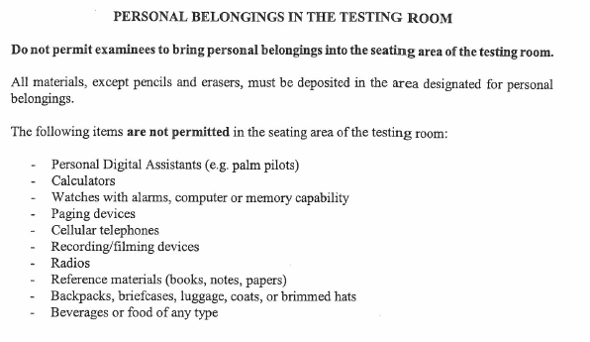
NBME Chief Proctor’s Manual

Slide 27
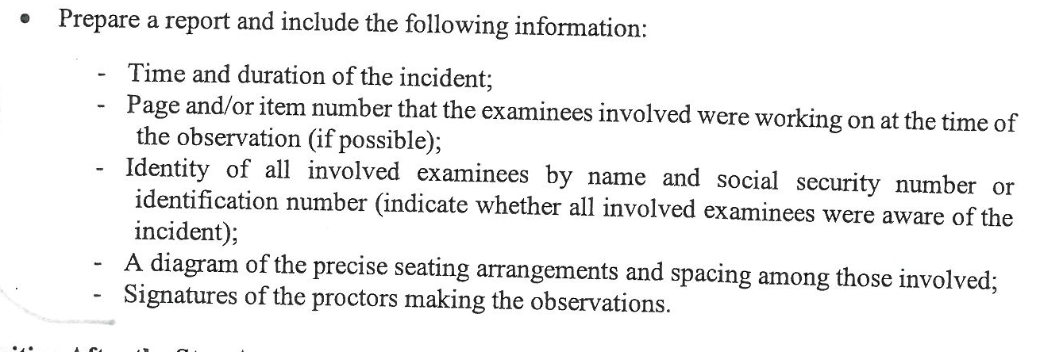
In the Event of Cheating
NBME Chief Proctor’s Manual

Slide 28
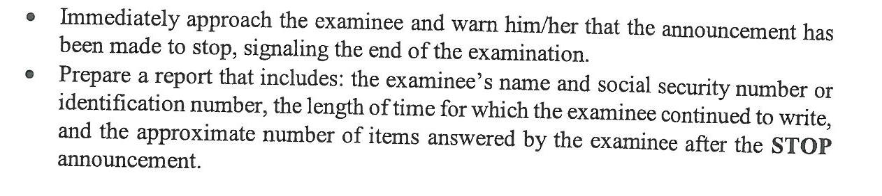
In the Event of Cheating
NBME Chief Proctor’s Manual

Slide 29
NBME Chief Proctor’s Manual

Slide 30
NBME Chief Proctor’s Manual

Slide 31
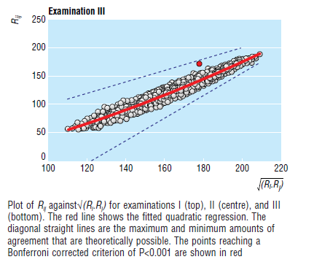
Acionyx is a computer program
Modified Angoff’s method
Finds undue similarity between pairs of candidates
Need to compare seating plans etc.

Slide 33

NBME Analysis
For a FEE on request, the NBME will do a testing analysis in cases of suspected misconduct
Agreement Analysis

Slide 34
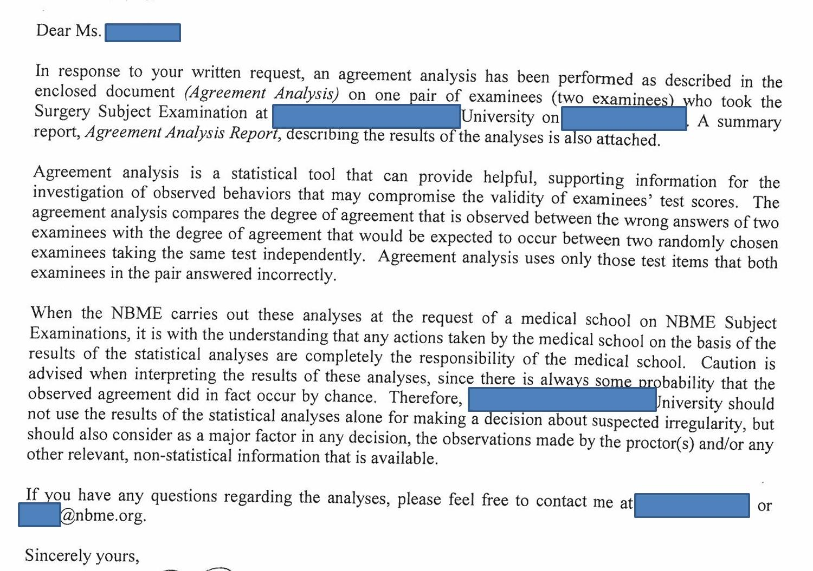

Slide 35
WHAT SHOULD THE CONSEQUENCES BE FOR CHEATING?

Slide 36
Treatment
Most faculty favor official hearing
Administration usually fears expulsion because of litigation
Others think counseling may be appropriate
Medical Students are usually more lenient in their view
Wagner RF. Academic Medicine. 68(12) 1993

Slide 37

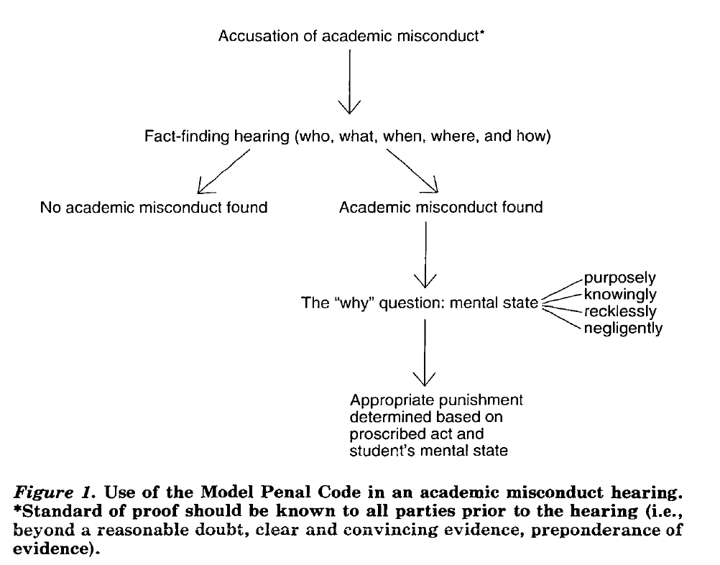


Slide 38
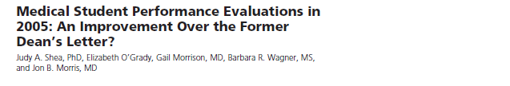
MSPE
Provides summary of student performance
Should provide mention of professionalism and actions
Most MSPE do not do this
Only 13 % had a distinct section

Slide 39
Needs to be mandatory reporting of adverse behaviors
Kunsoor et al. South Med J. 2013; 106(8): 479-483

Slide 40
HOW DO YOU PREVENT THIS
FROM HAPPENING
IN THE FIRST PLACE?

Slide 41
Prevention of Cheating
Students needs to be introduced to definitions of misconduct
Need to be made aware of penalties
Introduction of PASS / FAIL grading system
Kunsoor et al. South Med J. 2013; 106(8): 479-483

Slide 42
Honor Codes
Honor Codes work if:
  Define consequence of unethical behavior
  Communicate expectations with students
  Establishment of a culture of integrity
Students need to be educated about how to proceed if they observe cheating
McCabe DL et al. Ethics Behav 2001;11:219-232

Slide 43
Prevention of Cheating
What have we done at VCU
  Room
  Proctors
  Elimination of all electronic devices
  Spot checks from clerkship directors
  Reminder of consequence of cheating at Orientation

Slide 44
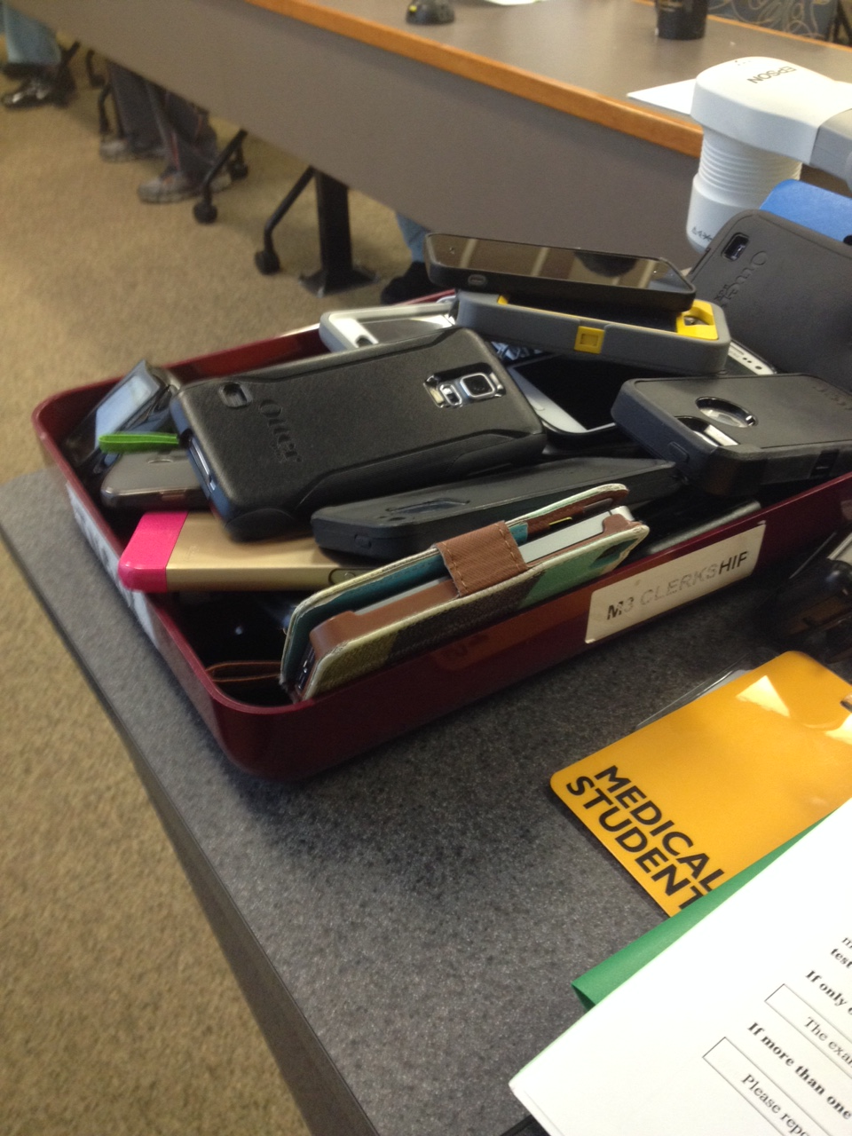
Elimination of electronic Devices

Slide 45
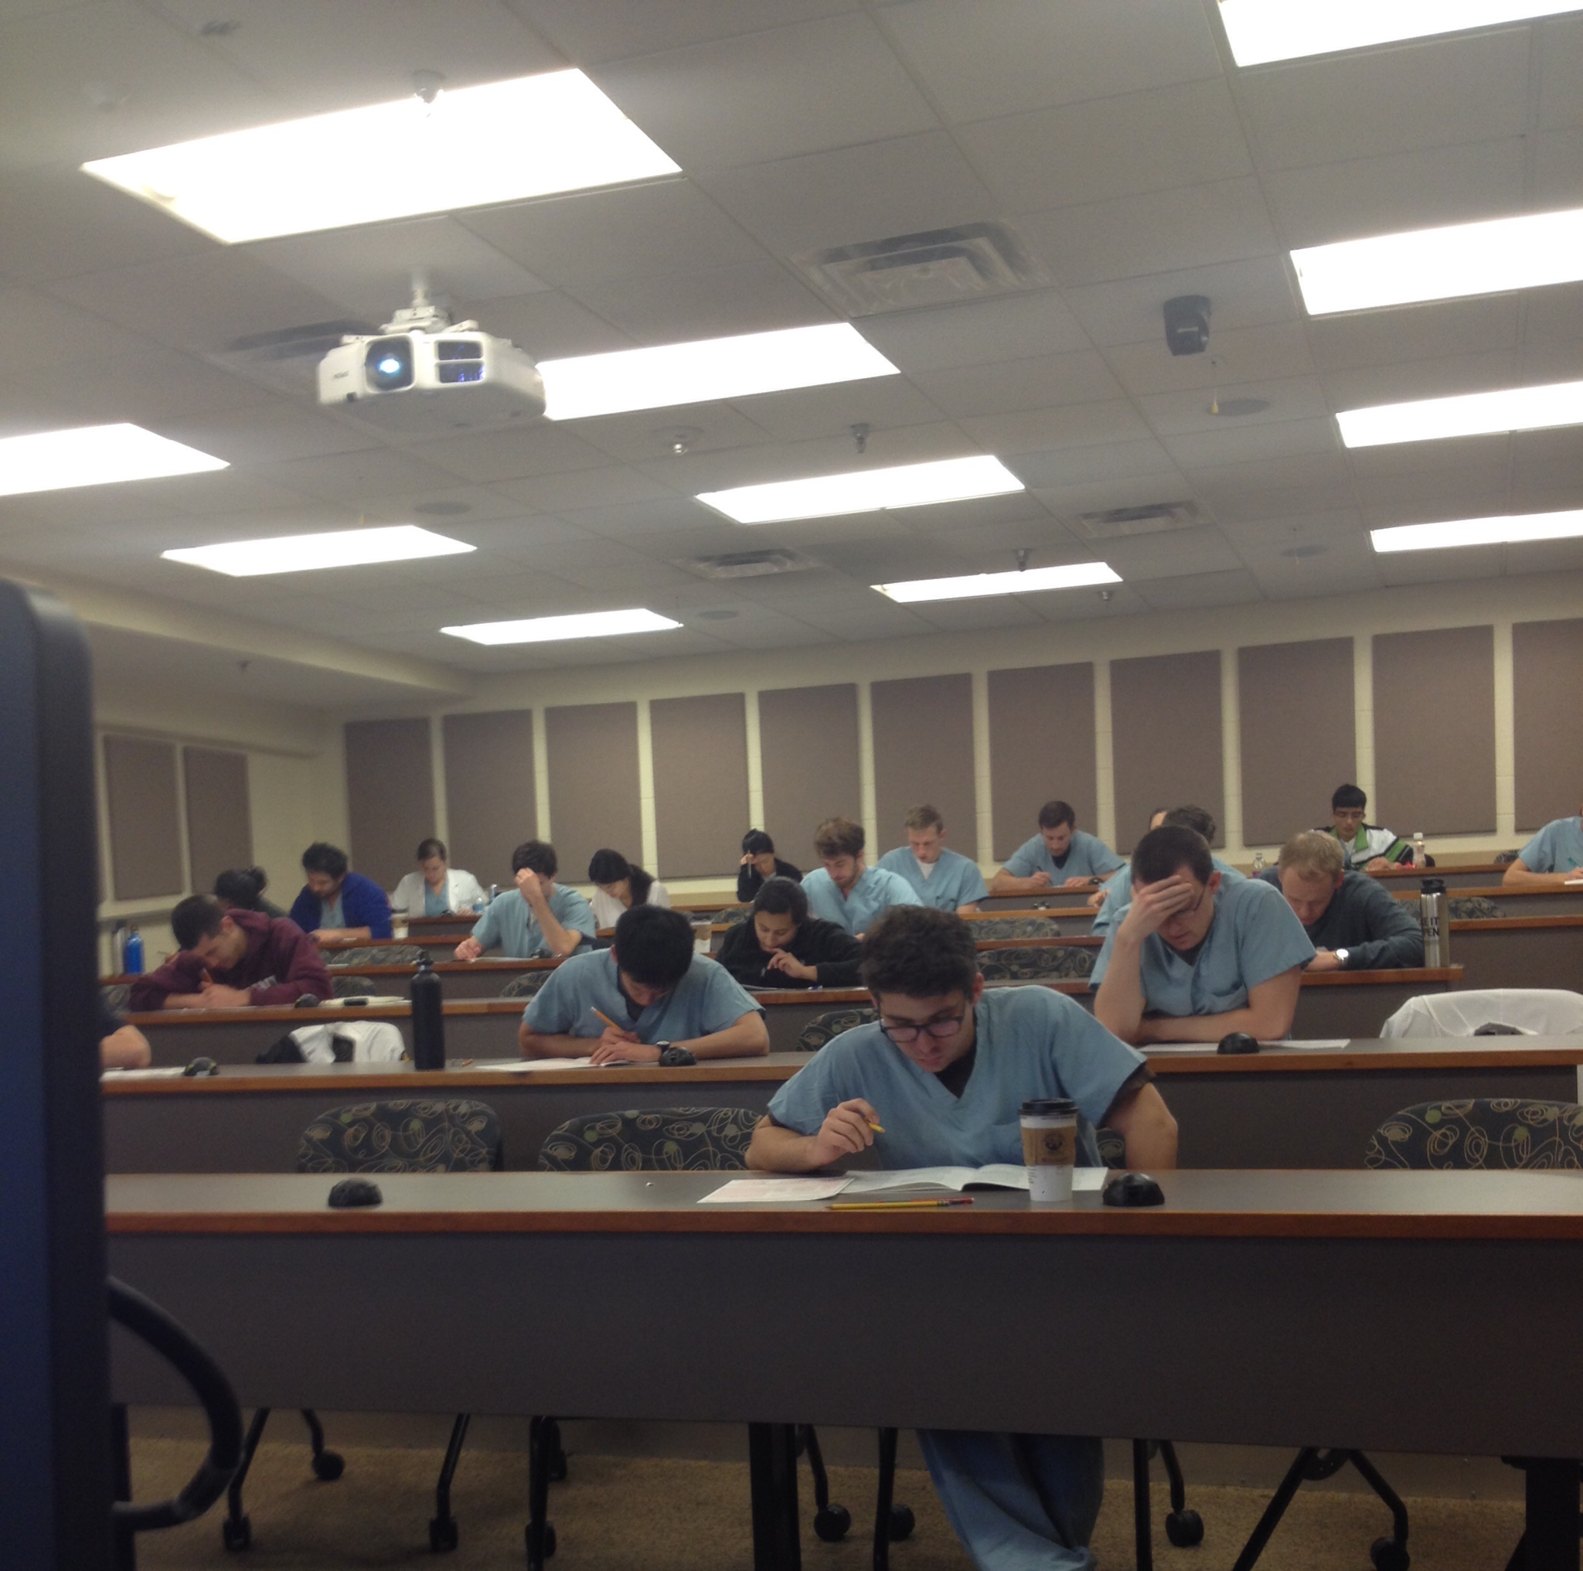
Room

Slide 46


Proctors

Slide 47
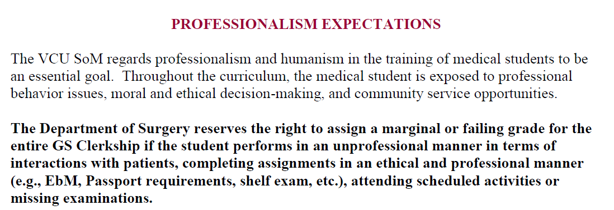
Orientation setting of Expectations

Slide 48
VCU MSPE
We have a dedicated section for Honor Code Violation

Slide 49
VCU MSPE

Slide 50
Case Study
Behavior observed by 3 witnesses
General Announcement made
Behavior Continues
Seating chart created
Test Ends
Deans Office contacted
Office of Academic Integrity contacted
NBME contacted for testing analysis
Students cleared of wrongdoing

Slide 51

Summary
Cheating Happens
It may be related to burnout
Be “wise” to cheating methods
Use your institutional resources
Be familiar with NBME testing policy
Be vigilant at shelf exams
Work with your Deans Office on MSPE

