Slide 1

Effective Mentoring for Students
Brian D. Saunders, MD, FACS
Associate Professor of Surgery and Medicine
Director of Undergraduate Surgical Education
Penn State College of Medicine
Trouble Shooting Your Clerkship 105
April 22, 2015

Slide 2


Disclosures
None

Slide 3
Objectives
To describe the mentoring process and its central role in professional development
To identify the risks and benefits for all parties in a mentoring relationship
To dispel some common myths about mentoring

Slide 4

What do you do all day?
Endocrine surgeon
Teacher
Investigator
Administrator
Mentor
Mentee

Slide 5
Why?

Slide 6
“No man is an island”
“Meditation XVII,” John Donne

Slide 7

Definition
men·tor
noun \ˈmen-ˌtȯr, -tər\ : someone who teaches or gives help and advice to a less experienced and often younger person

Slide 8
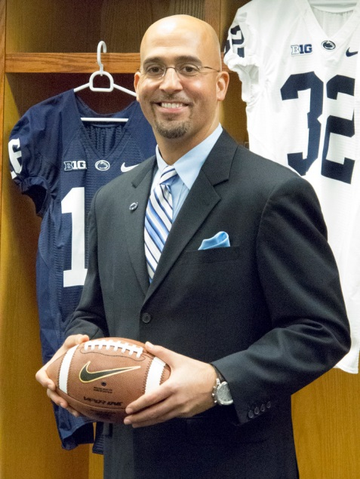
Synonyms
Coach | Guru
Trainer | Tutor
Advisor | Teacher
Counsellor | Instructor
Guide | Parent

Slide 9

The goal of a mentoring relationship
To build capacity and self reliance in the mentee

Slide 10


It is not …
Making clones
Dealing with underperforming individuals
Dealing with personal issues
Therapy
Allowing people to moan/whine/vent …..
  except, maybe sometimes

Slide 11


Mentors
Vs.
Role Models
Sought for 1:1 consultation
Know their mentees
Interactive
Observed and imitated
May not know audience
Passive

Slide 12

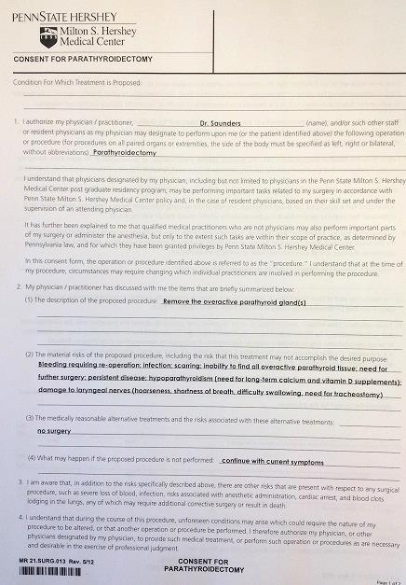
The process of mentoring

Slide 13

Stages of mentoring
Initiation
Cultivation
Separation
Redefinition

Slide 14

Critical elements
Respect
Trust
Listening skills

Slide 15
Types of mentoring functions
Career
  Help the mentee learn the ropes and prepare for career advancement
Psychosocial
  Help the mentee develop a sense of competence and clarity of identity

Slide 16
Hidden curriculum
Model the behavior you are asking of others
The mentee unconsciously adopts aspects of the mentor’s thinking, behaviors, and/or style

Slide 17

Qualities of a mentor
Positive:
  Sincere desire to help
  Sound judgment
  Independent thinking
  A tendency to think divergently
  Good humor
  Trustworthy and ensures confidentiality

Slide 18
Qualities of a mentor
Negative:
  Attempts to undermine or compete with mentee
  Dominates the relationship
  Seeks a clone
  Does the work for the mentee
  Manages the mentee as a supervisor would
  Know-it-all

Slide 19
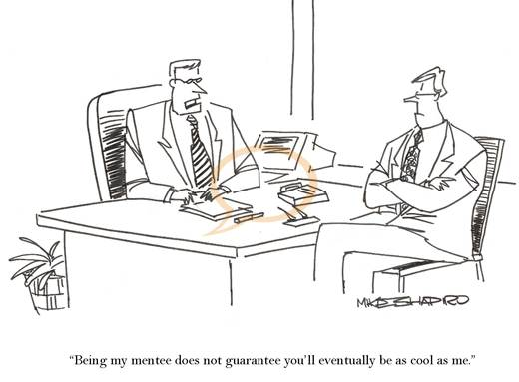

Slide 20
Qualities of a mentee
Positive:
  Takes initiative (to begin and drive the relationship)
  Goal oriented
  Seeks, accepts, and acts on feedback
  Listens
  Takes an active role in their own learning
  Self-aware
  Allocates time and energy for the relationship
  Responsible for commitments

Slide 21
Qualities of a mentee
Negative:
  Know-it-all
  Unwilling to expend the time
  Avoids decisions and relies exclusively on the mentor
  Submissive
  Acquiesces to or over-idealizes the mentor

Slide 22

Advantages of mentoring
Mentor:
  Career enhancement
  “Passing the torch to a new generation”
  Learning (new technologies, new developments)
  Share their expertise with another
  Prove themselves as valuable leaders
  Obtain a fresh perspective on the development process
  Invest in the career of others
  Recognition

Slide 23
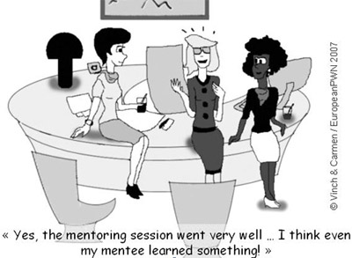

Slide 24
Advantages of mentoring
Mentee:
  Career advancement
  Professional identity
  Experienced guidance and support
  Increased self-awareness and self-discipline
  An expanded personal and professional network
  A sounding board for testing ideas and plans
  Constructive feedback on personal and professional development areas
  Doors opened
  Different perspective

Slide 25

Risks of mentoring
Mentor:
  Time and energy commitment to mentee
  Mentee dependence on mentor
  Negative halo from mentee who fails

Slide 26

Risks of mentoring
Mentee:
  Overdependence on mentor
  Micro-management of mentor
  Negative halo from mentor who fails

Slide 27

Myths of mentoring
Mentoring is monogamous (can be teams)
It only happens on a long-term, face-to-face, basis
Mentors needs to be older and more experienced
Only the mentee gains benefits
Taking the time to mentor decreases productivity

Slide 28
Advice to potential mentors
Recognize that mentee may be uncomfortable with asking for help – break the ice by sharing some of your career experiences
Stay in your zone of expertise/experience
Extend the mentee’s network – suggest additional mentors to address unique needs
Be clear that the mentee sets the pace
Advise, do not manage

Slide 29
What does the research reveal?
With mentoring in academic medicine …
  Mentees rate overall well-being as higher
  Mentees have an increased sense of security, hope about the future, and motivation
Mentoring was deemed an important influence on:
  Personal development
  Career guidance
  Research productivity (publications, grant success)
  Development of professional competence
  Establishing professional network
    Allowed students to identify themselves more as doctors

Slide 30
Additional conclusions
Most surveyed say lack of mentoring is the #1 or #2 most important factor hindering career progress in academic medicine
Women perceive more difficulty finding mentors
Same gender or same race matches are not essential
Maintaining clear boundaries is essential for an effective relationship

Slide 31
Truly complete mentor
Serves as an advisor/guide, developer of talent/coach, opener of doors/advocate, role model, interpreter of organizational or professional rules, protector, rule setter/boss, and carries on all of these functions of a long- term basis.
W. Silen, MD
Dean for Faculty Development and Diversity,
Harvard Medical School, 1998
Notes:
…

Slide 32

Thank you
bsaunders@hmc.psu.edu

